Slide 1
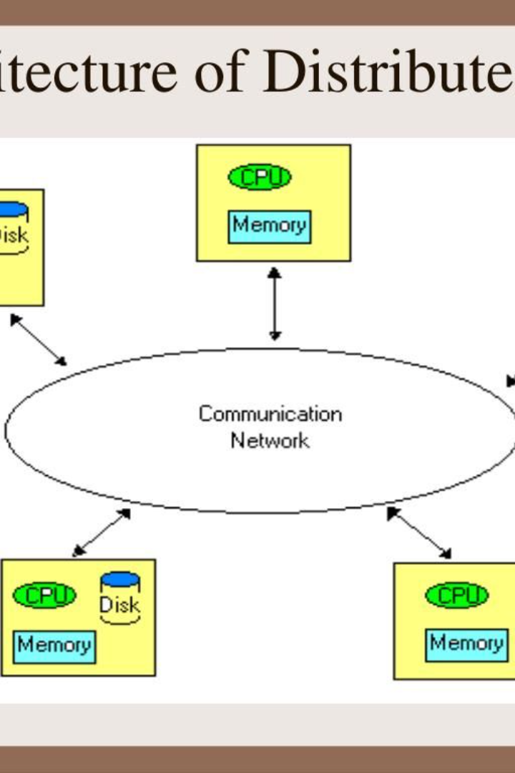

Introduction to Distributed Operating Systems
Distributed operating systems (OS) are designed to work across multiple machines, providing a consistent environment for applications and users.

Slide 2
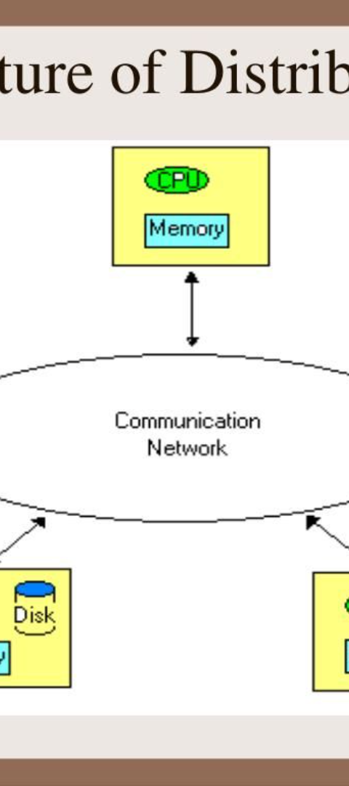
What is a Distributed OS?
1
Decentralized Structure
2
Inter-Process Communication
A distributed OS spans over multiple independent machines, offering enhanced reliability and scalability.
It facilitates communication and data sharing between processes running on distinct nodes.
3
Resource Management
Efficiently allocates resources across the network, ensuring optimal performance.

Slide 3
Benefits of Using a Distributed OS for Chat Applications
Scalability
Redundancy
Efficient Resource Utilization
Allows chat systems to handle large numbers of users and messages without performance degradation.
Provides fault tolerance, ensuring continuous operation even if some nodes fail.
Optimizes utilization of hardware resources, minimizing latency and improving user experience.

Slide 4
Challenges and Considerations in Building a Distributed OS Chat
1
Consistency
2
Concurrency Control
3
Security
Ensuring consistent views across distributed nodes without compromising performance or responsiveness.
Protecting data and communications from unauthorized access, interception, and tampering.
Managing concurrent access to shared data while preserving data integrity.

Slide 5
Key Features and Functionalities of a Distributed OS Chat
1
Message Routing
2
Replication
3
Eventual Consistency
Efficiently delivering messages to the intended recipients across the distributed system.
Replicating data to ensure availability and fault tolerance in case of node failures.
Ensuring data consistency eventually rather than immediately across the distributed system.

Slide 6



Case Studies of Successful Distributed OS Chat Applications
Slack
Discord
Zoom
Revolutionized team communication and collaboration with its distributed chat platform.
Known for its low-latency voice chat and seamless integration with gaming communities.
Providing reliable video conferencing and instant messaging across diverse devices.

Slide 7

Best Practices for Developing and Maintaining a Distributed OS Chat
Modularity
Scalable Architecture
Implementing modular design to enable easy extensibility and maintenance.
Designing for horizontal scalability to support growing user bases and message loads.
Monitoring and Analytics
Utilizing comprehensive monitoring and analytics tools for performance optimization and issue resolution.

Slide 8
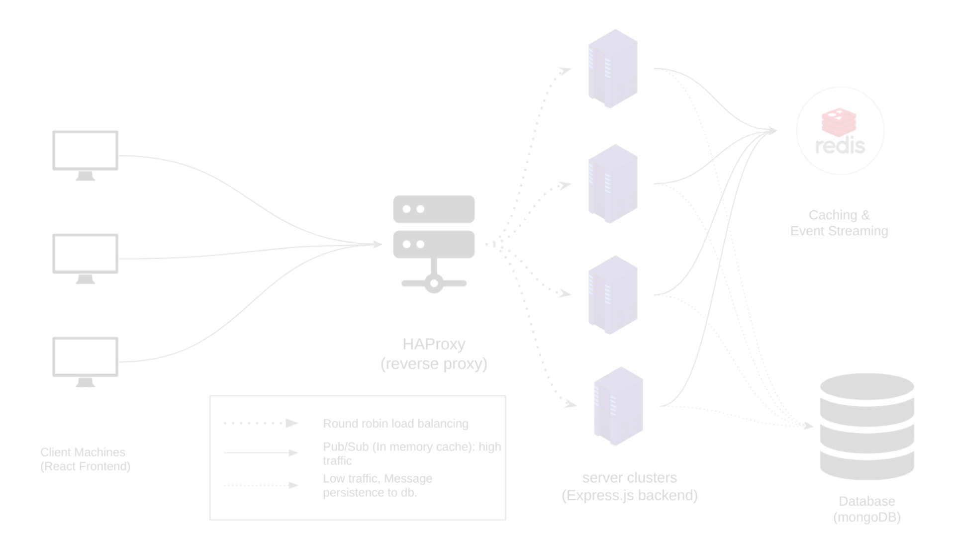



Conclusion and Future Prospects for Distributed OS Chat
Enhanced Integration Capabilities
Security Innovations
AI and Automation
Advancements in secure communication protocols and encryption mechanisms.
Utilization of AI for enhanced user experiences, automated moderation, and content recommendations.
New integration opportunities with IoT, smart devices, and cloud services.

